Slide 1
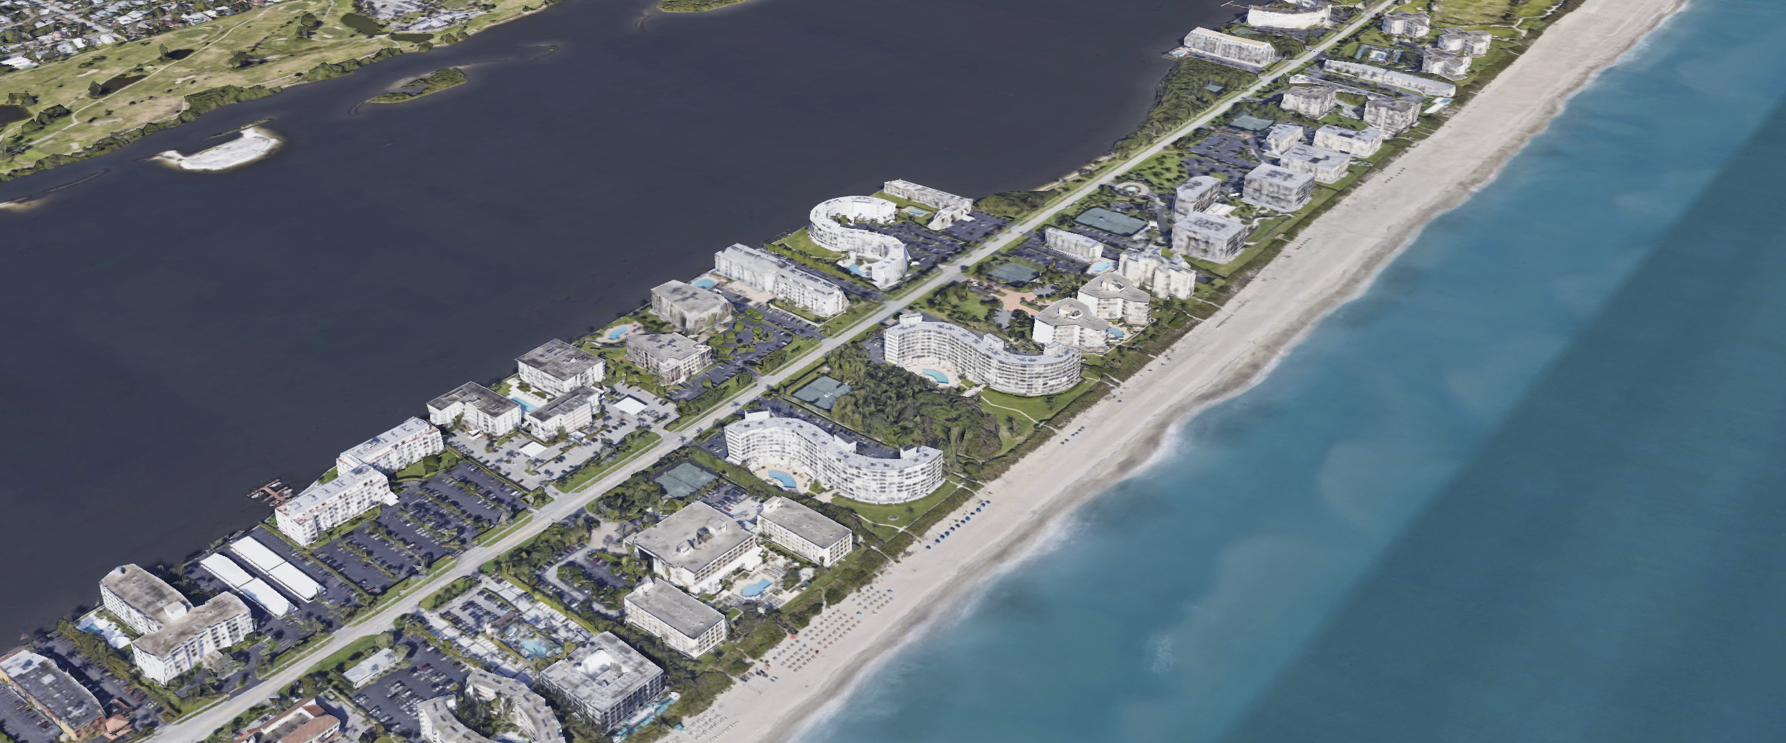
Zoning for the Future of the South End
TOWN OF PALM BEACH
Town of Palm Beach, Florida – Zoning Code Update
Notes:
Introduction – Town’s zoning consultant working on zoning code review. 1974 code was indeed focused on the south end – before the 1974 code the code was a derivation of the 1929 code. The south end was not what the south end is today until the 1960’s. The threat that was responded to was the high-rise tower. The 1974 code put an end to that and capped height at three stories for the next 50 years. The result, the development pattern of the south end is frozen in time. My job is not to judge decisions of the past, but to assist the town in setting the regulatory table for its future. The future of the south end is in your hands. The south end is on the precipice of change. The day the south end changed forever – the date of the surfside collapse. The coastal condominium in Florida changed forever that day. It opened the door for high assessments, buy outs, and redevelopment. Our challenge is to shape the development pattern and form of the redevelopment – when it comes. It starts with ideation. It starts with your voice.

Slide 2
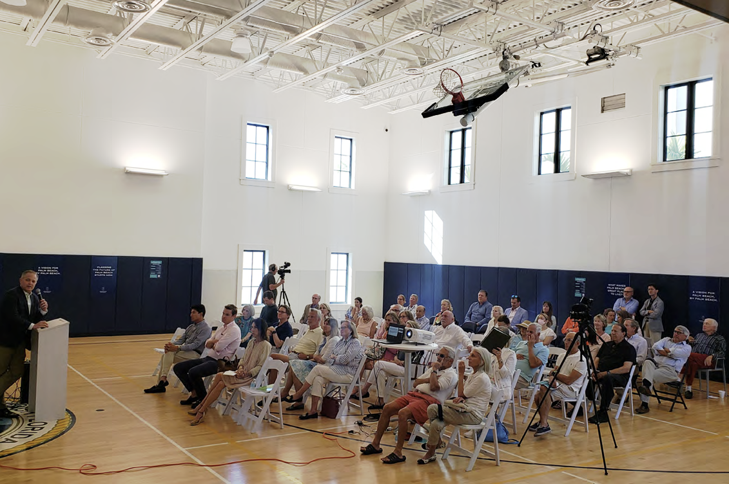
Designing Our Palm Beach Summary
TOWN OF PALM BEACH
Town of Palm Beach, Florida – Zoning Code Update
Notes:
Many of you joined us at the Designing Our Palm Beach charrettes one year ago.

Slide 3
Town of Palm Beach, Florida – Zoning Code Update
Notes:
What we concluded based on our review and engagement with you. There are some sites that are not achieving their highest and best use. They will set the stage for the form and character of the next generation of development in the south end. The south end is disconnected from the rest of Palm Beach and is a series of islands on an island. Access to water and views of water is of paramount importance. Parking is an interesting issue – surface parking, underground parking, structured podium parking; A1A is a limiting factor in the South End. Two lanes – State DOT – high traffic volume. Unlikely to change.

Slide 4
Town of Palm Beach, Florida – Zoning Code Update
Notes:
Some ideas that came out of the charrette include building a podium to address lake level rise – build on that.

Slide 5
Town of Palm Beach, Florida – Zoning Code Update
Notes:
Park under the podium

Slide 6
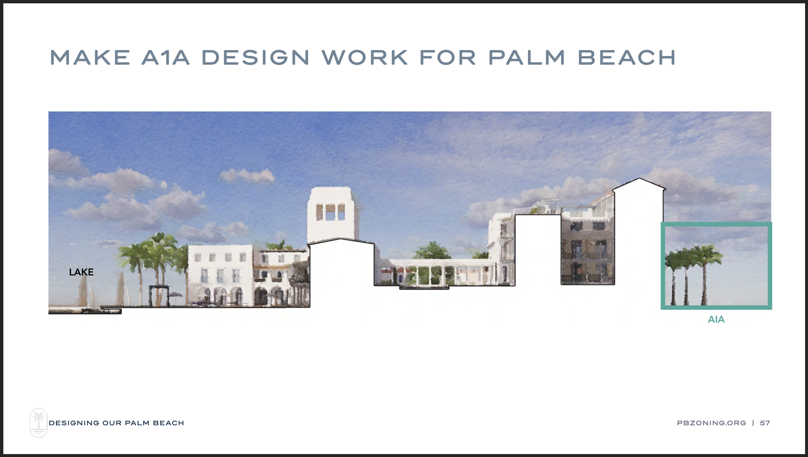
Town of Palm Beach, Florida – Zoning Code Update
Notes:
Try to incoroporate A1A – slow it down – make it more pedestrian friendly.

Slide 7
South End Zoning
Town of Palm Beach, Florida – Zoning Code Update
Notes:
Do away with the box to articular buildings, provide more PB like designs, and preserve viewsheds.

Slide 8
South End: Existing Conditions
TOWN OF PALM BEACH
Town of Palm Beach, Florida – Zoning Code Update
Notes:
So what is the South End today – how did we get here?

Slide 9
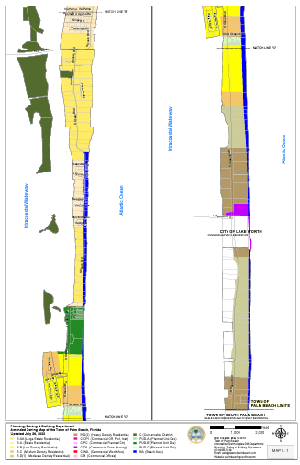
3.20 miles long. .20 miles at its widest. 350 acres. 65 acres of public recreation (not including beach). 6.70 acres of tennis courts. 86 condo buildings, 2,000 units. 60% of total condo units in the Town. 5–10-acre sites. 3 to 8 story buildings – most 50-70 feet high. 2/3 of buildings built before 1980; most built in the 1960’s and early 1970’s.
South End Snapshot
Town of Palm Beach, Florida – Zoning Code Update
Notes:
It is a 3.20 mile long - .20 mile wide – 350 acre part of PB that is about 20% public recreation – comprised of 86 condo buildings and over 2,000 units – makes up 60% of all condos in PB – most 3-8 stories – 50-70 feet high – the higher ones built before the 1974 code.

Slide 10
Notes:
This shows the heights.

Slide 11
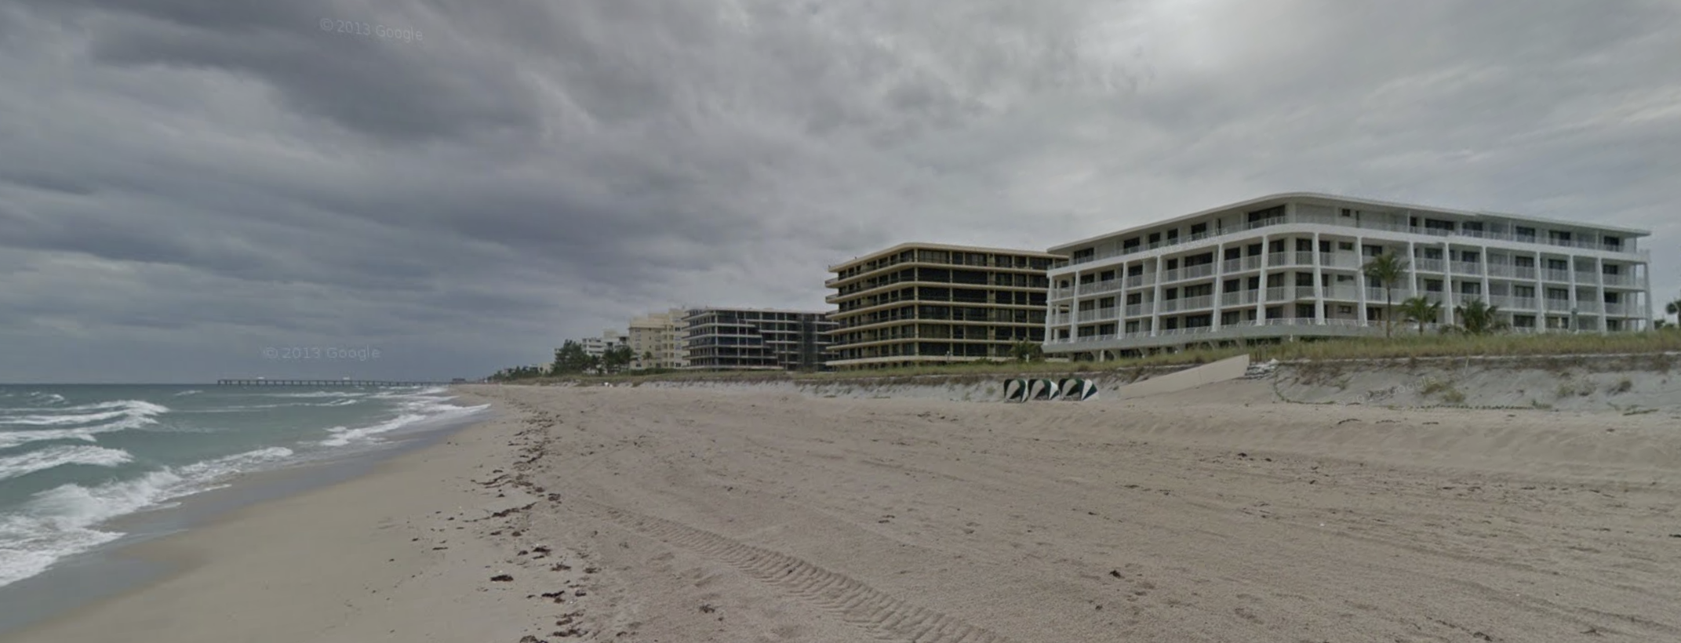
How Zoning Shaped the South End
TOWN OF PALM BEACH
Town of Palm Beach, Florida – Zoning Code Update
Notes:
How did zoning shape the South End?

Slide 12
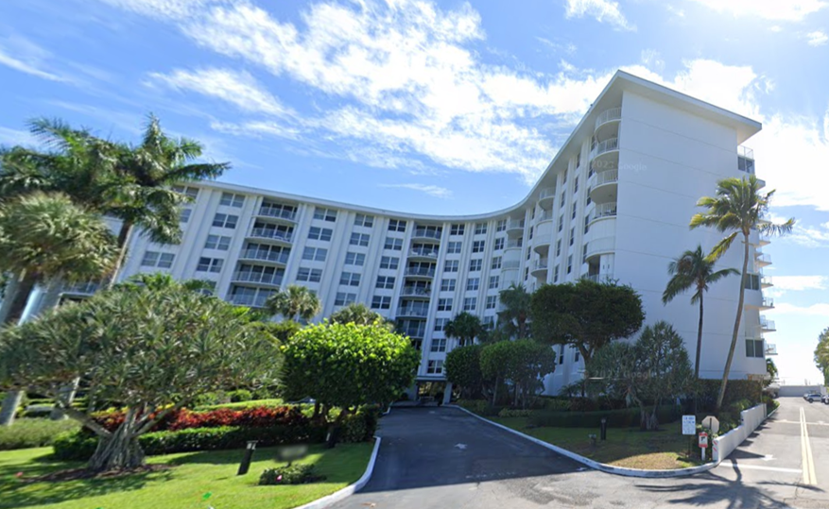
Pre-1974 Zoning - 8 stories or 90 ft. max. height. - 150 ft. setback from bulkhead line. - “Motels” permitted by right. - Accommodates single-family residences and condo buildings.
Town of Palm Beach, Florida – Zoning Code Update
Notes:
Pre-1974 – 8 stories of 90 feet was permitted – these are technically high-rise buildings – bulkhead setbacks; motels permitted by right

Slide 13
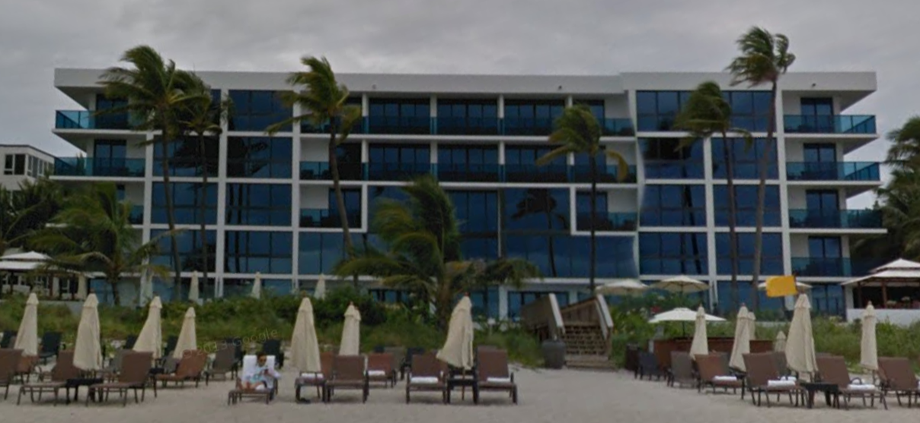
Post-1974 Zoning - 1/3 R-D(1), 1/3 R-D(2), 1/3 R-B and R-C + 25-acre PUD. - Residential, hotel, and limited restaurant uses. - Buildings capped at 25 feet (2 stories) and 35 feet (3 stories). - Development pattern frozen in time.
Town of Palm Beach, Florida – Zoning Code Update
Notes:
5 different zones – all residential – varying degrees of density and only one allowing hotels and limited restaurants serving individual condo buildings – height caps at 2 and three stories. Boxy development pattern frozen in 1974.

Slide 14
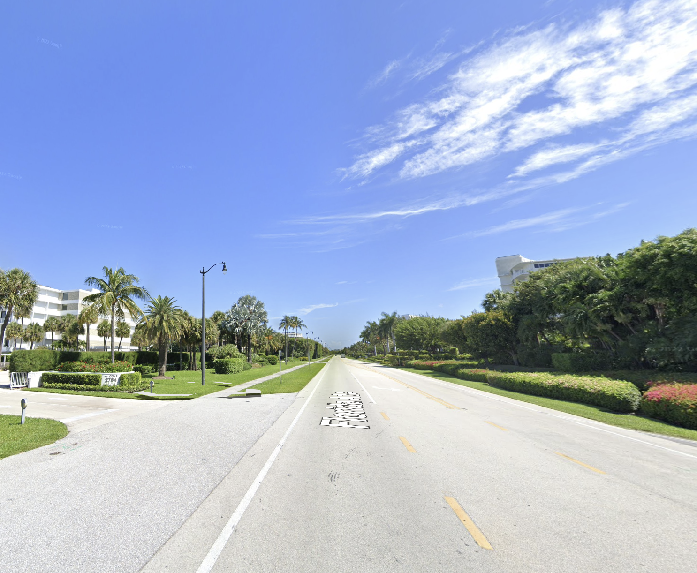
The Future of South End Zoning
TOWN OF PALM BEACH
Town of Palm Beach, Florida – Zoning Code Update
Notes:
How can zoning shape the future development patterns of the South End?

Slide 15
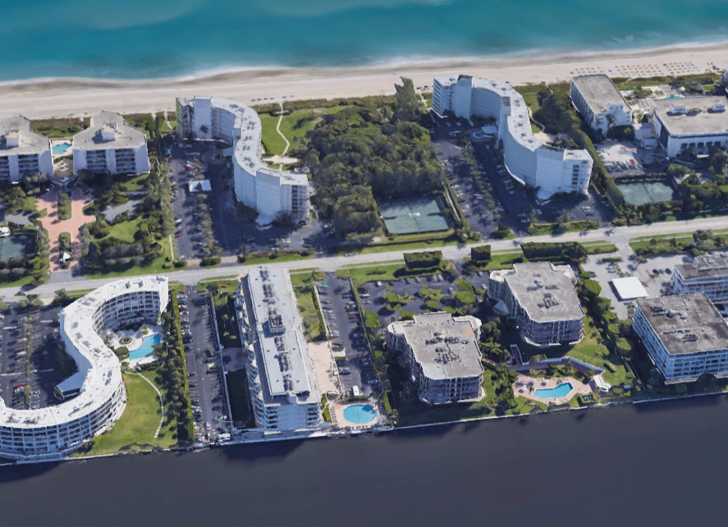
South End Opportunities - A unique maintenance free lifestyle in Palm Beach. - Condo living; low maintenance Palm Beach lifestyle. - A connection to water. Beachfront and lakefront living in Palm Beach at a more manageable price point for more people. - Publicly available recreational opportunities (i.e. golf, parks) - Water, water, water. - Views, views, views. - Very valuable land.
Town of Palm Beach, Florida – Zoning Code Update
Notes:
What are the opportunities? Maintenance-free living unlike other parts of PB which requires constant maintence; condo-living; waterfront public rec opportunities; water, views, extraordinary value

Slide 16
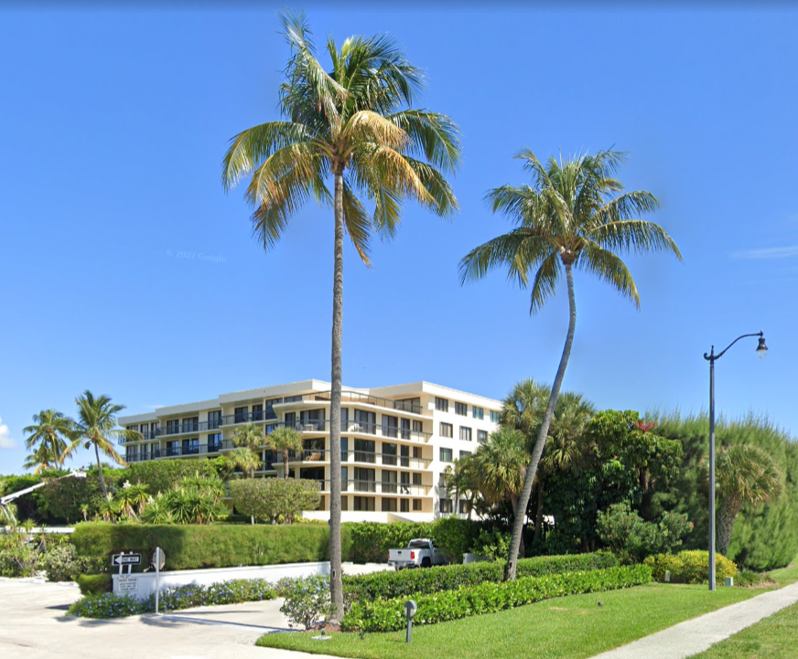
- Aging buildings needing maintenance and repairs – inspections. - Changing tastes and preferences – low ceilings. - Concerns over assessments. - 2,000 units on a two-lane road. - Sea level rise on the lake side. - Monolithic buildings. - A place frozen in time. - Competition from other South Florida addresses. - Very valuable land.
South End Challenges
Town of Palm Beach, Florida – Zoning Code Update
Notes:
But the South End currently has aging buildings in various states of maintenance and repair; changing tastes and preferences; assessments; 2,000 units on a two-lane road; lake level rise; competition; frozen built environment

Slide 17
- Rethink setbacks (bulkhead line, front yards). - Rethink heights and rooflines. - Rethink monolithic boxes (height limits promote flat roof boxes). - Protect viewsheds through building placement and site line controls. - Unfreeze the development pattern and allow for redevelopment in form that balances the interests. - Introduce design guidelines that make the South End more architecturally and aesthetically connected to Mid-Town.
Zoning Considerations
Town of Palm Beach, Florida – Zoning Code Update
Notes:
So, what should we consider as new developments come along – orientation of the buildings to A1A and the water; bulk, scale, massing, and design of buildings; protecting views; unfreezing the development pattern but creating appropriate guardrails that promote a more unique and PB like built environment that protects property rights. There is surely more and that is what we want to hear from you. What should we be considering as we consider the future of the South End? You know this place best – we look forward to hearing from you. Thank you.

Slide 18
www.pbzoning.org
TOWN OF PALM BEACH
Town of Palm Beach, Florida – Zoning Code Update
Notes:
Thank you and visit pbzoning.org to keep informed about the project.

