Slide 1
MILESTONE INSPECTION / BUILDING RECERTIFICATION PROGRAM RESIDENTIAL CONDOMINIUMS & COOPERATIVES

Slide 2
Surfside, Florida – Champlain Towers South Collapse
June 24, 2021
12 Story Building
Building 40 Years Old
98 People Died
Only Broward County and Miami / Dade County had building recertification requirements at the time
Champlain Towers South just received their 40-year recertification inspection, but the condo board had not started any major structural repairs by the date of the building collapse

Slide 5
TOWN INITIAL RESPONSE AND ACTIONS:
Town sent out letter on June 29, 2021(5 days after the Surfside disaster) putting all building owners on notice of the State regulations regarding condominium associations and their mandate to maintain common areas of their buildings – AND – encouraged building owners to undertake safety inspections of their buildings, similar to the Broward and Miami - Dade County Recertification programs.
Staff joined the Palm Beach County League of Cities Task Force to help draft County Regulations for Recertification of Buildings after the Surfside building collapse.
Staff drafted a Recertification program, ready to be adopted by Town Council, but held off to see what regulations would be adopted by the County or State.

Slide 6
2022 SB-4D & 2023 SB-154 – Efforts to Ensure Residential Condominium & Cooperative Safety and Financial Stability
Created Statewide Building Milestone Inspections.
Required Structural Integrity Reserve Studies (SIRS).
Prohibited the Ability to Waive or Reduce Structural Integrity Reserves.
2022 SB-4D Established the State Program; 2023 SB-154 Provided Some Limited County & Municipal Changes to the Program

Slide 7
F.S. 553.899
553.899 Mandatory structural inspections for condominium and cooperative buildings.—(1) The Legislature finds that maintaining the structural integrity of a building throughout the life of the building is of paramount importance in order to ensure that buildings are structurally sound so as to not pose a threat to the public health, safety, or welfare. As such, the Legislature finds that the imposition of a statewide structural inspection program for aging condominium and cooperative buildings in this state is necessary to ensure that such buildings are safe for continued use.

Slide 8
FBC Chapter 1, Section 110.9
110.9 Mandatory structural inspections for condominium and cooperative buildings.
110.9.1 General.
The Legislature finds that maintaining the structural integrity of a building throughout its service life is of paramount importance in order to ensure that buildings are structurally sound so as to not pose a threat to the public health, safety, or welfare. As such, the Legislature finds that the imposition of a statewide structural inspection program for aging condominium and cooperative buildings in this state is necessary to ensure that such buildings are safe for continued use.

Slide 9
Milestone Inspection Program Starting Year
If the Building is 30 Years Old Before 7/1/2022 – Milestone Inspection Before 12/31/2024.
If the Building is 30 Years Old Between 7/1/2022 and 12/31/2024 – Milestone Inspection Before 12/31/2025.
If the Building is 30 Years Old On or After 12/31/2024 – Milestone Inspection At 30 Years of Age.

Slide 10
Substantial Structural Deterioration
“Substantial structural deterioration” means substantial structural distress or substantial structural weakness that negatively affects a building’s general structural condition and integrity. The term does not include surface imperfections such as cracks, distortion, sagging, deflections, misalignment, signs of leakage, or peeling of finishes unless the licensed engineer or architect performing the phase one or phase two inspection determines that such surface imperfections are a sign of substantial structural deterioration.”

Slide 11
Process: Create List of Buildings

Slide 12
Process: Send Out Letters
Filtered County P.A. List of Buildings
Sent to 111 Building Owners
Certified Mail
Phase One Milestone Inspection Due Within 180 Days
Will Re-issue Letters if More
Time is Needed in 2024

Slide 13
Process: Phase One Milestone Inspection
“Milestone inspection” means a structural inspection of a building, including an inspection of load-bearing elements and the primary structural members and primary structural systems as those terms are defined in s. 627.706 (Insurance Rates & Contracts), by an architect licensed under chapter 481 or engineer licensed under chapter 471 authorized to practice in this state for the purposes of attesting to the life safety and adequacy of the structural components of the building and, to the extent reasonably possible, determining the general structural condition of the building as it affects the safety of such building, including a determination of any necessary maintenance, repair, or replacement of any structural component of the building. The purpose of such inspection is not to determine if the condition of an existing building is in compliance with the Florida Building Code or the firesafety code.”

Slide 14
Process: Milestone Inspection Report – Phase 1
Demonstrates Compliance With New State Law, Not FBC
List of Needed Repairs Included
Qualitative Inspection
Is a Phase 2 Milestone Inspection Required – Evidence of Substantial Structural Deterioration?

Slide 15
Process: Phase 2 Milestone Inspection and Report, If Required
May Involve Destructive Testing

Slide 16
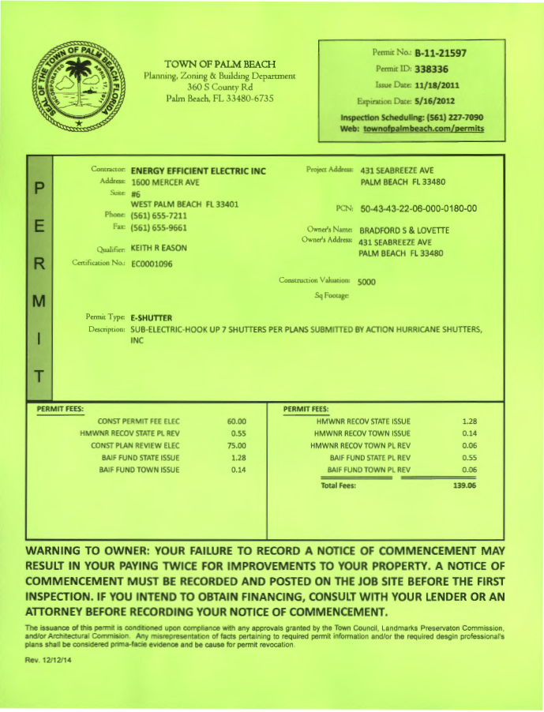
Process: Apply for Town Building Permits, If Repair Work is Required
Stand Alone Permit
Annual Facilities Permit
Required Work to be Commenced Within 365 Days of the Report

Slide 17
Process: Town Tracking
Town Maintains:
Date of Initial Mailing
Phase 1 Reports
If Substantial Structural Deterioration Was Found
Phase 2
Next Inspection Year (10 Years From Date of Milestone Inspection)

Slide 18
Questions ?

